Slide 1
Predicting the Next Spotify Hit - Key Findings
Best Model: Random Forest Regressor
Final RMSE: 15.758
What makes an unpopular song?
High acousticness (1.31)
High instrumentalness (2.09)
Non-explicit songs
Low danceability (-1.23)
What makes a popular song?
Neutral acousticness (-0.14)
Explicit songs
Slightly low speechiness (-0.44)

Slide 2
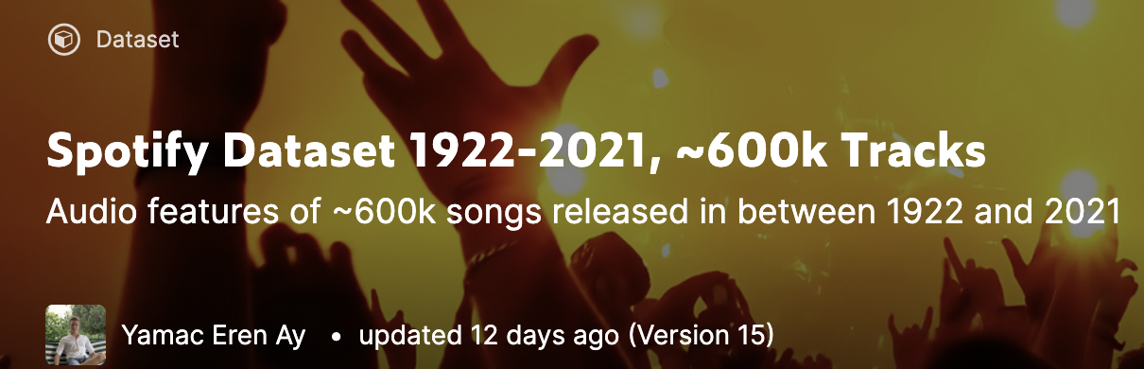
Dataset
174389 rows
19 columns of song metadata and audio features
Features include: acousticness, danceability, energy, explicitness, key
Target feature: popularity

Slide 3
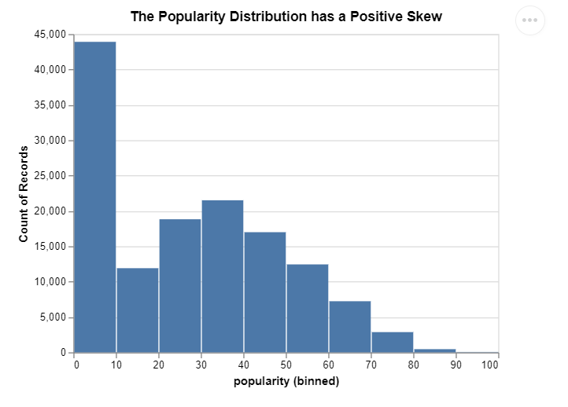
Exploratory Data Analysis

Slide 4
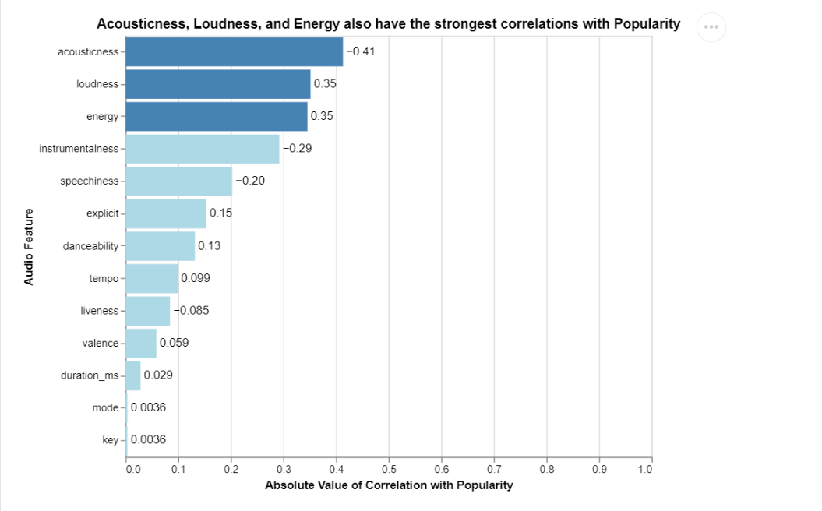
Exploratory Data Analysis

Slide 5
Modeling
01
02
03
Linear Regression
Decision Tree Regressor
Random Forest Regressor
04
05
06
K Neighbors Regressor
Grid Search Random Forest Regressor
Grid Search Random Forest Regressor with 10/15 top features
18.20 RMSE
22.43 RMSE
15.84 RMSE
19.70 RMSE
15.73 RMSE
(10 max features,
100 trees)
15.79 RMSE

Slide 6
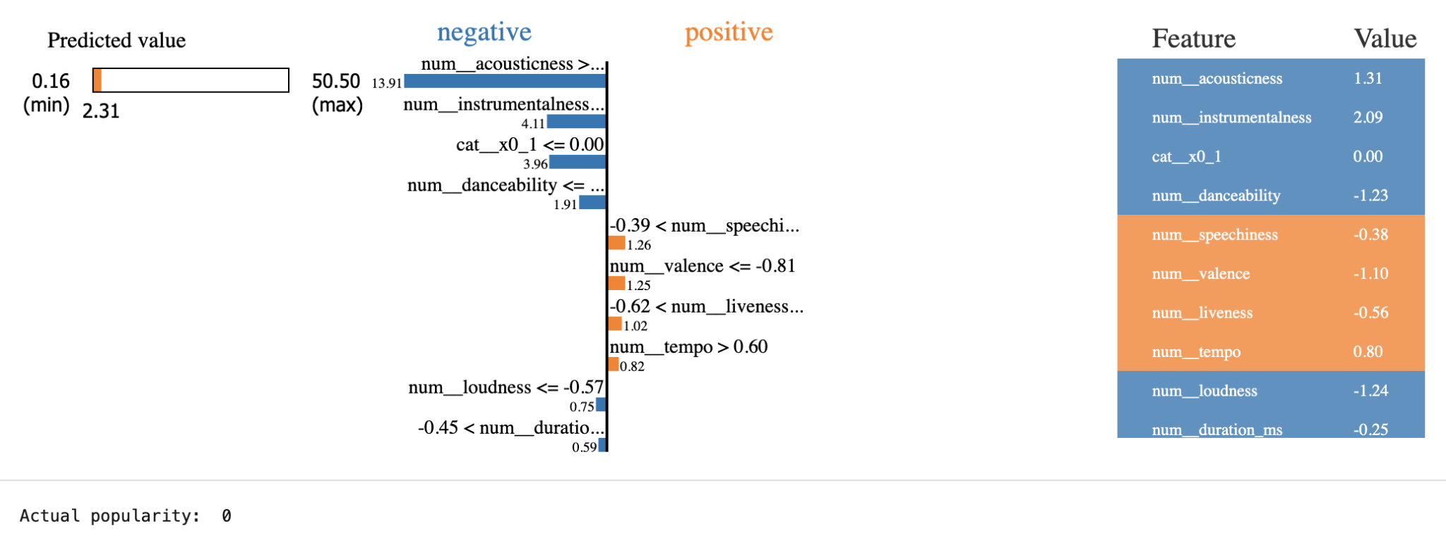
Predicting an unpopular song

Slide 7
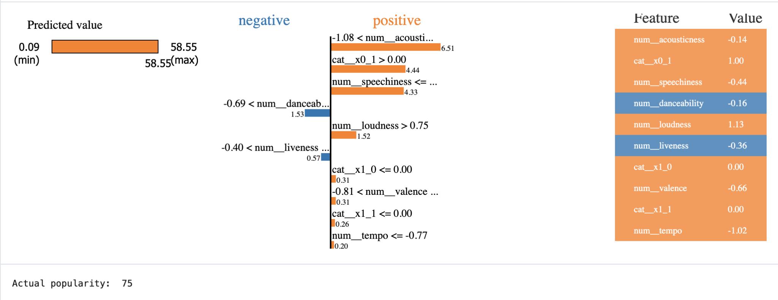
Predicting a popular song

Slide 8
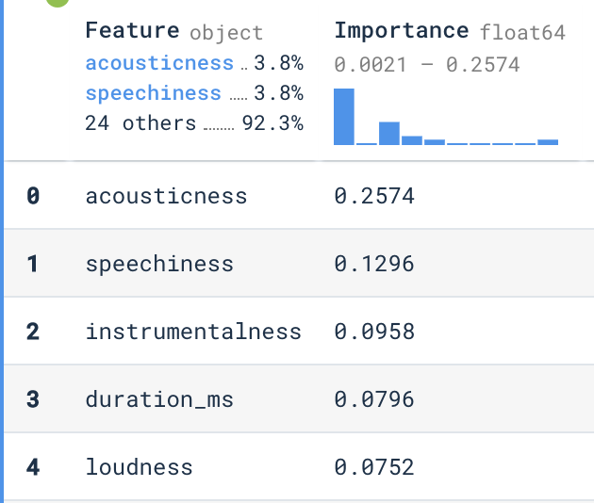
Acousticness is by far the most important feature

Slide 9
Predicting the Next Spotify Hit - Key Findings
Best Model: Random Forest Regressor
Final RMSE: 15.758
What makes an unpopular song?
High acousticness (1.31)
High instrumentalness (2.09)
Non-explicit songs
Low danceability (-1.23)
What makes a popular song?
Neutral acousticness (-0.14)
Explicit songs
Slightly low speechiness (-0.44)

Slide 10
Predicting the Next Spotify Hit
Austin Leung
Ivana Lin
Notes:
BLUF(outcomes), Dataset/Features, EDA(popularity skew, top correlated with popularity), Modeling(what models, fine tuning, errors, final error of best model), Feature contributions(lyme chart, most important), BLUF(outcomes)

